Slide 1

Project Blink
Proof of Speed - 1.0 Introduction

Slide 2
What is Proof of Speed?
Time based speed required competition. Results in either winning or loosing.
Based on Bandwidth, Computation and Trusted Delegation
Uses VDFs for timestamping transactions and accurate rewards
Uses Hash-based clocks for validation and to find block spaces and time-outs
Fixes Block time and size based on the efficiency of block producer nodes for the fixed time-interval (epoch)

Slide 3
What is Proof of Speed?
Cannot share bandwidth, so there is no shared pools, increases decentralization and minimizes 51% attacks
Predictable propagation of blocks using unique gossip protocols and streams data using snips - chunks of a block
Introduces a universal time-unit for blockchain known as legates to synchronize time
Rewards are based on hash-count i.e., the amount of time a node spends its computation to validate / mint transactions. This is known as Hash-rewards

Slide 4
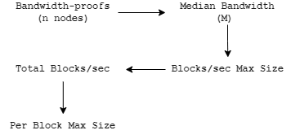

Slide 5
Next : 1.1 Block Architecture

